Slide 1
Trends in Nutrition and Carbon Footprint of Ontarians’ Dietary Choices
?
Basak Topcu, Sadaf Mollaei, Goretty Dias
WICI Workshop: Leveraging Systems Approaches to Improve
Human & Planetary Health
University of Waterloo
April 25th, 2018

Slide 2
Food Systems (Ericksen, P. J. 2008)
Production
Consumption
Socio-economic Feedback
Environmental Feedback
Social
Welfare
Food
Security
Environmental
Security
Image modified from Ericksen, P. J. (2008). Conceptualizing food systems for global environmental change research.

Slide 3
Food Systems (Ericksen, P. J. 2008)
Production
Consumption
Socio-economic Feedback
Environmental Feedback
Social
Welfare
Food
Security
Environmental
Security
Image modified from Ericksen, P. J. (2008). Conceptualizing food systems for global environmental change research.

Slide 4
Global GHG Emissions of Agriculture
Figure taken from IPCC. (2014). Summary for Policymakers, In: Climate Change 2014, Mitigation of Climate Change.

Slide 5
Quantifying CF of Food Products: Life Cycle Assessment
All greenhouse gas emissions to make a food product.
Cooking &
Consumption
Upstream of Farm Products
Transportation
To Household
Production
at Farm
Retail
Transportation To Processing
Transportation
To Retail
Processing
& Packaging

Slide 6
Research Questions
What is the CF of dietary patterns in Ontario?
How is this changing in the last 10-years?
?

Slide 7
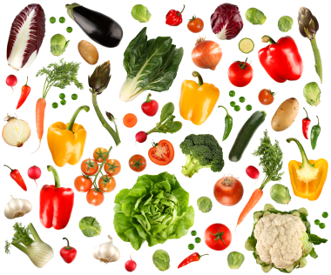
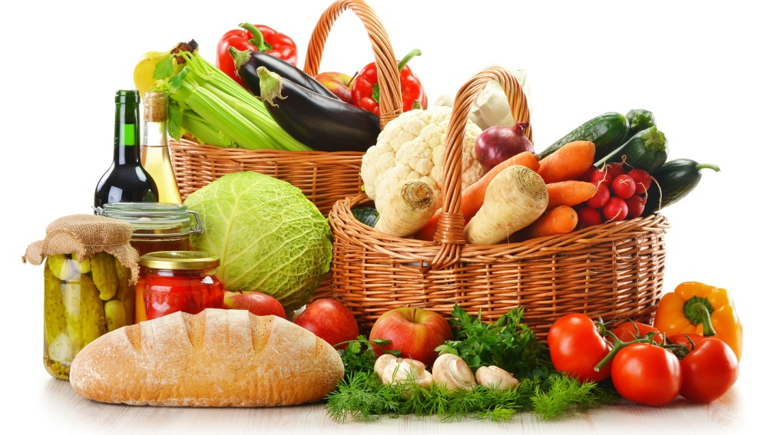
Methodology
?
Analyze food consumption
&
identify dietary patterns
Quantify 2015 CF of each food basket
&
Compare with 2004 CF
(Veeramani, 2017)
Formulate 2015 annual food baskets
2004 & 2015
Canadian
Community
Health
Survey

Slide 8
10-Year Trend of Ontario Food Consumption
16% in total food consumption weight
Shift from Red Meat → Poultry & Fish

Slide 9
10-Year Trend in Daily Calorie & Protein Intake of Actual Food Baskets
Recommended daily calorie intake (2294 kcal)
Recommended daily protein intake (51 protein gram)

Slide 10
10-Year Trend in CF of Actual & Nutritionally-Balanced Food Baskets
kg CO₂ eq.
kg CO₂ eq.

Slide 11
CF Contribution of Food Categories & Products Omnivorous Actual Food Basket
Food Products
Beef
Meat &
Alternatives
Others

Slide 12
Conclusions
Diets high impact on environment
Plant-based (vs animal-based) products → lower CF
Shift towards plant-based products
LCA systems method: diet - environment
LCA CF is only one aspect;
Water footprint, land use, biodiversity loss, etc.

Slide 13
References
Ericksen, P. J. (2008). Conceptualizing food systems for global environmental change research. Global Environmental Change, 18(1), 234–245. https://doi.org/10.1016/j.gloenvcha.2007.09.002
IPCC. (2014). Summary for Policymakers, In: Climate Change 2014, Mitigation of Climate Change. (Contribution of Working Group III to the Fifth Assessment Report of the Intergovernmental Panel on Climate Change). Cambridge University Press, Cambridge, United Kingdom and New York, NY, USA. Retrieved from https://www.ipcc.ch/pdf/assessment-report/ar5/wg3/drafts/fgd/ipcc_wg3_ar5_summary-for-policymakers_approved.pdf
Veeramani, A., Dias, G. M., & Kirkpatrick, S. I. (2017). Carbon footprint of dietary patterns in Ontario, Canada: A case study based on actual food consumption. Journal of Cleaner Production, 162, 1398–1406. https://doi.org/10.1016/j.jclepro.2017.06.025

Slide 14
Thank you

